Slide 1
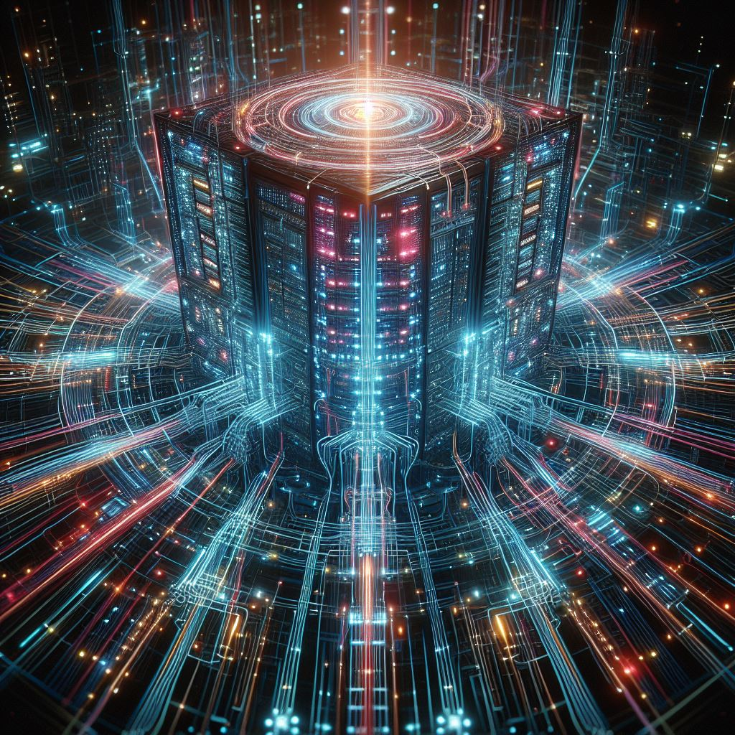
The Immortal Retrofuturism of Mainframe Computers
and how to keep them safe!

Slide 2
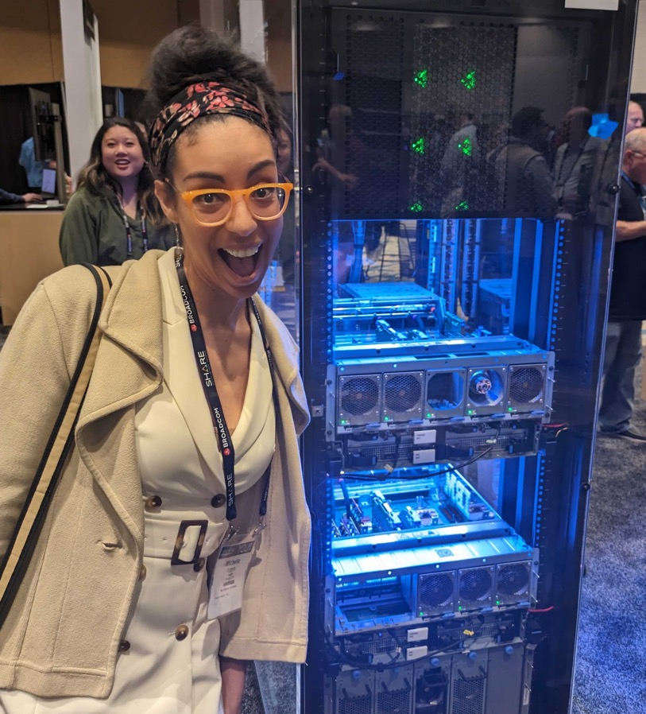
Who am I?
Michelle Eggers
Security Consultant @ NetSPI
Mainframe, Web App, Network Penetration Testing
Background in accounting/finance and project mgmt
Passionate about legacy tech security

Slide 3
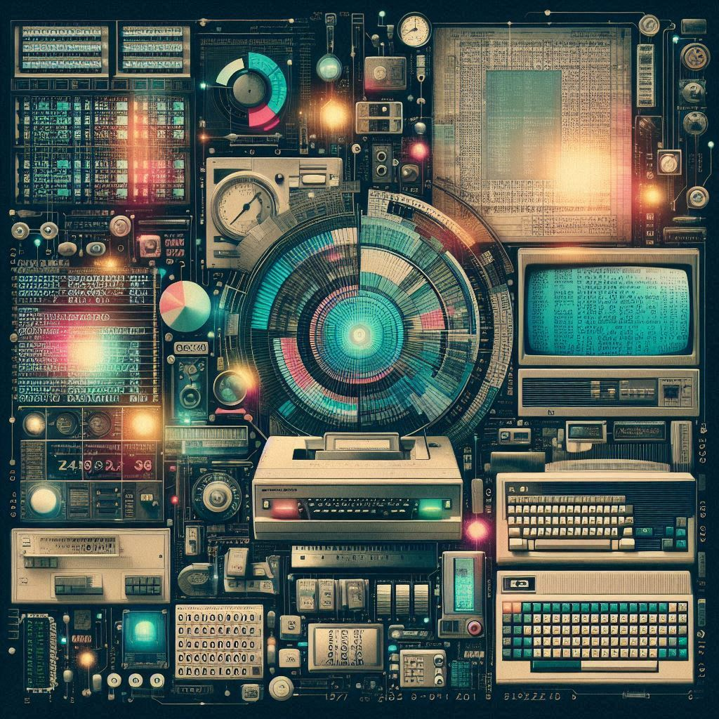
Overview
History Debrief
Mainframes Today
Modern Threats
Tips to Secure

Slide 4
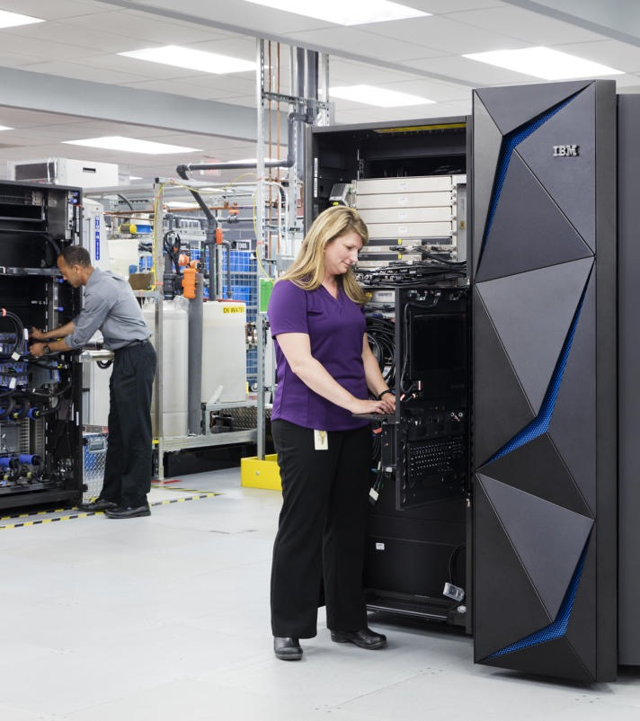
What is Mainframe??
They are computers!
More specifically, they are high-performance computer systems with immense processing and storage power that have unique operating systems, like z/OS or Linux on IBM Z.

Slide 5
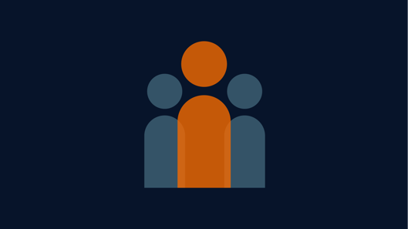
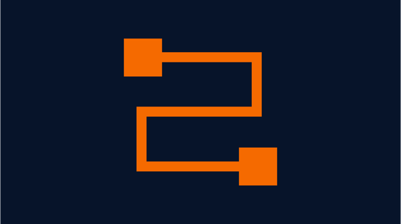
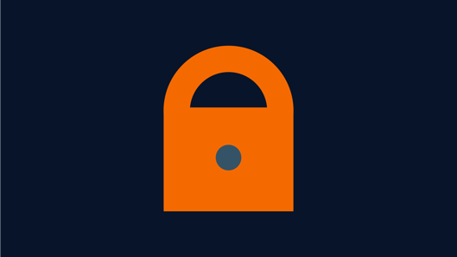
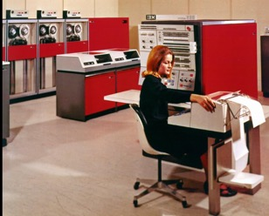
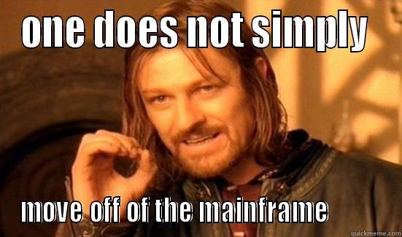

Myth vs. Fact
Myth: Mainframe is Outdated
Myth: Cloud Replaces Mainframe
Myth: It’s too specialized!
Mainframes continuously evolve and were among the earliest systems to adopt virtualization and built-in encryption
Regulatory compliance, barriers to transition.
Hybridization is more likely! ELT approach is developing to load mainframe data into lakes for analysis
Changes underway to make mainframes more accessible. WatsonX AI Code Assist for translation of COBOL to Java and initiatives to enlist early career professionals.

Slide 6
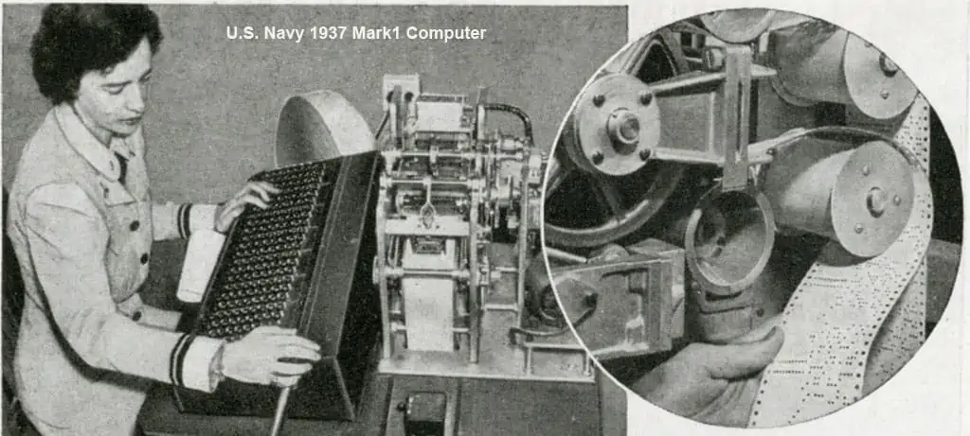
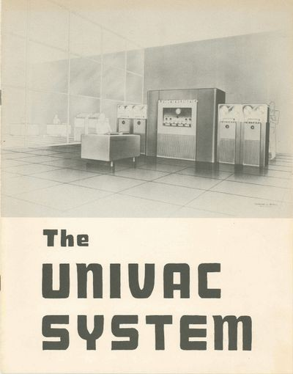
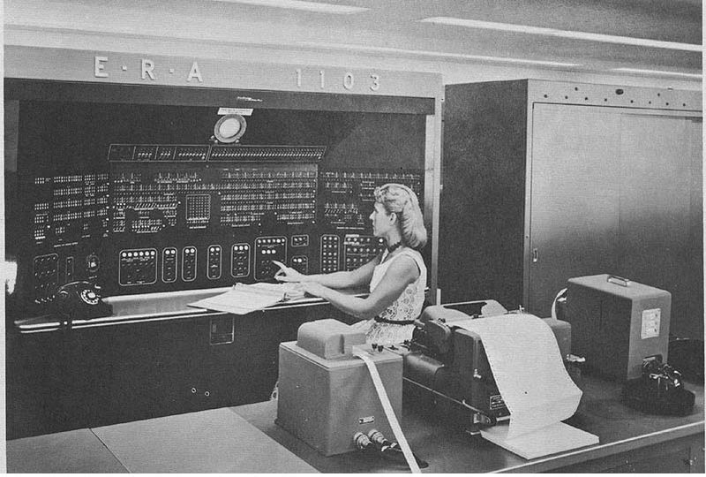
A Brief History!
1937
US Navy Bureau of Ships
- Pre-mainframe technologies in use: Analog computers, mechanical calculators, electrical tabulating machines
- Used for gunnery calcs, navigation, and engineering tasks
1951
Eckert-Mauchly Computer Corp
- Commercialization Occurs
- UNIVAC created to process census data
- Magnetic tape, faster than punch cards

Slide 7
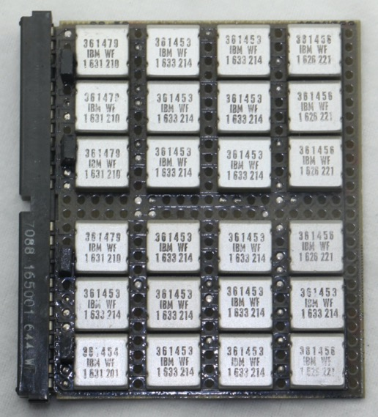
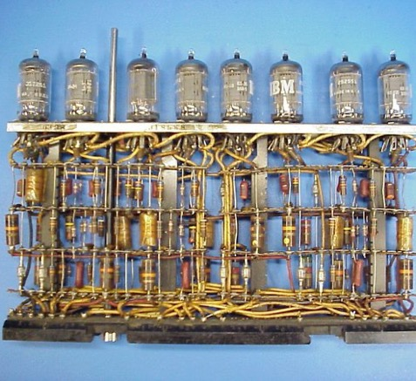
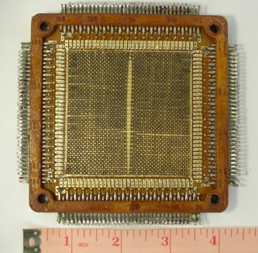
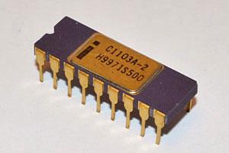
Time Marches On!
1965
IBM
- Modern IBM Z System/360 released with unified architecture
- First computers designed to cover a complete range of applications, unified architecture
- Solid state tech replaced vacuum tubes
1970
Innovation Continues!
- Magnetic ferrite cores were replaced by silicon DRAM memory chips
- Virtual memory introduced
- Dynamic address translation

Slide 8
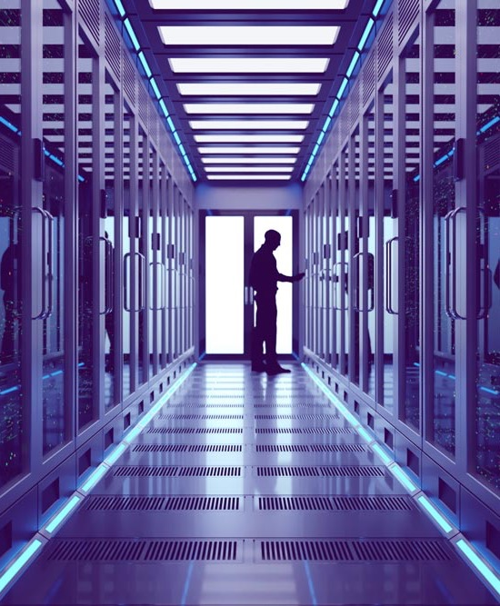
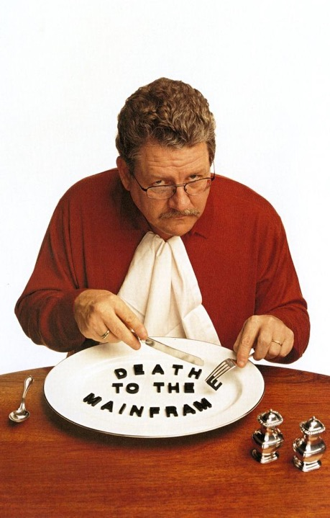
The Saga Continues!
1991
Death Announcement
- Mainframes were publicly stated to have only a few more years of relevance
- "I predict that the last mainframe will be unplugged on March 15, 1996.“ Stewart Alsop
2024
The Future is Now
- Mainframe is STILL IN USE by finance, healthcare, government, and aviation industries
- New developments include implementing AI to improve real-time fraud detection capabilities

Slide 9
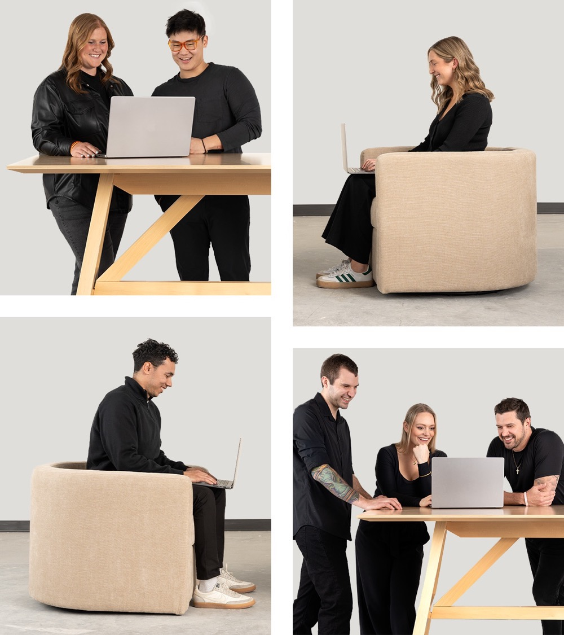
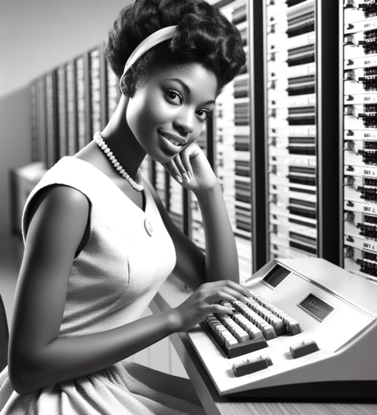
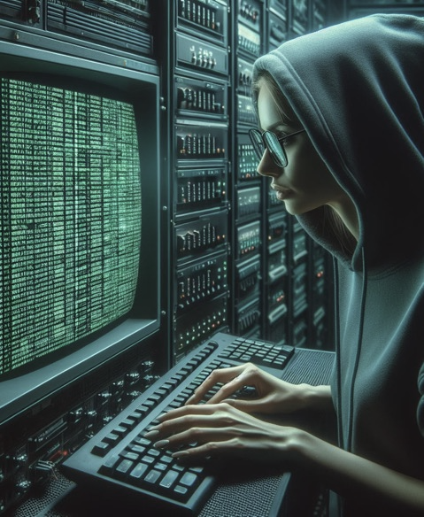


Amazing Mainframe
Five nines of reliability!
Less than 5.36 minutes of downtime!
Reliability
Availability
Serviceability
- Built-in redundancy across various hardware levels (I/O paths, power supply, memory, processors)
- Error detection/correction of data corruption.
- Can handle up to 7 magnitude earthquakes!
- Transaction rollback
- Checkpoint restart
- Complex job scheduling
- z15 offers 190 configurable cores = finely tuned; “bespoke”
- Modular by design
- In-depth logging – problem solving that much easier
- Onsite, accessible for repair and maintenance
- Tightly controlled access

Slide 10
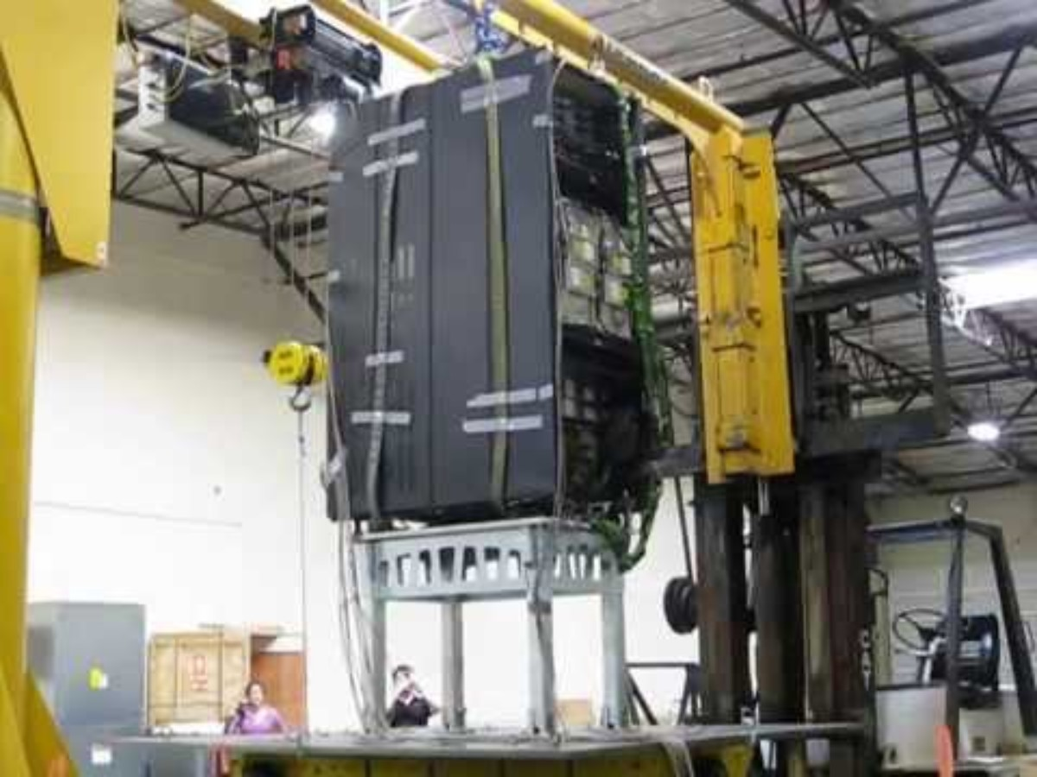

Slide 11
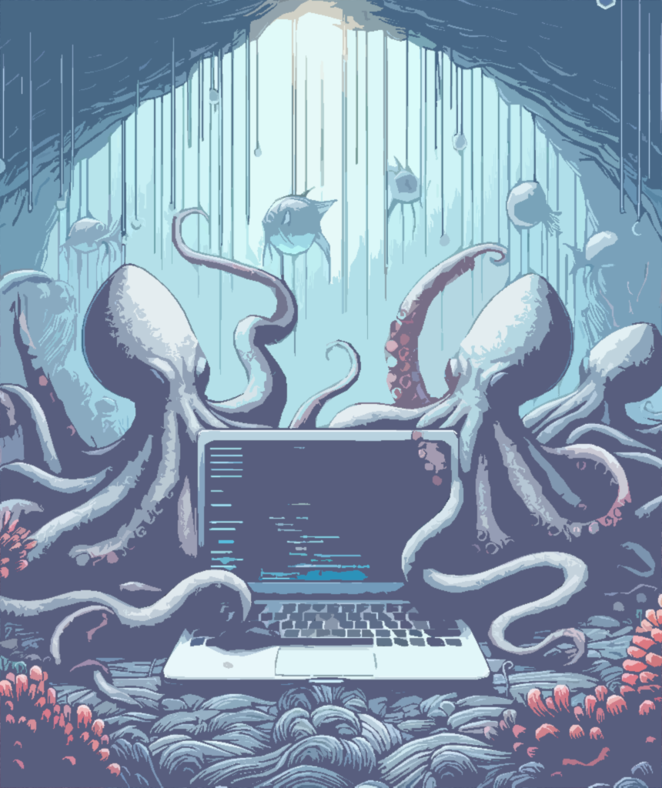
Environmental Threats
Expanded attack surface = more potential vulnerabilities
TJX Companies Data Breach (2005-2007)
Payment card data breach
Exposed 45.7 million credit/debit card number
Weakness in wireless network used to pivot into mainframe
Heartland Payment Systems (2008-2009)
100 million cards compromised
Global cyber fraud operation
Combined attack of network and application vulnerabilities
that the attackers exploited to access data stored on the mainframe
Equifax Data Breach (2017)
Private data of 147 million users exposed
Web application provided the initial access

Slide 12
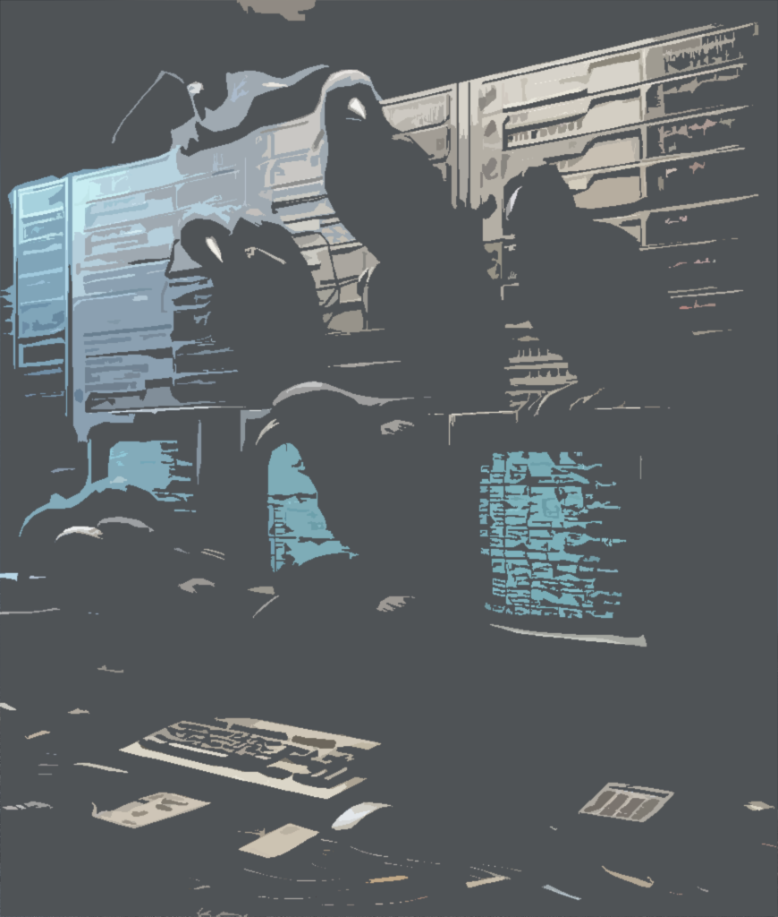
Environmental Threats
Small Mistakes, Big Problems
Logica Data Breach (2012)
Swedish data breach that dramatically changed how the federal government viewed mainframe security
The entire investigation was made public
What happened?
  Initial access via insecure FTP network connection
  Likely, hackers used Hercules (mainframe emulator) to run z/OS and download files and tax-processing source code from the Logica servers
  Attack included 0-day vulnerabilities that leveraged default configurations and sysadmin command execution
  120k Usernames were stolen from RACF and corresponding passwords cracked using John the Ripper
  Funds were also stolen from banking institutions by the primary hacker, based in Cambodia

Slide 13
Next up: Simulated real-world attack
Authentication to the logical partition (LPAR)
Endpoints have already been enumerated in this walkthrough
Access is restricted for low-level users to specific resources
Is there another way to access?

Slide 14
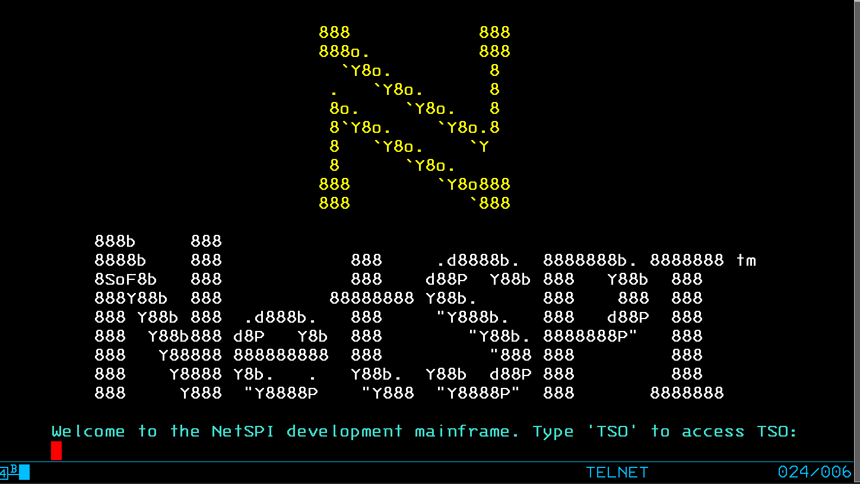
Real Life Network -> Mainframe Compromise

Slide 15
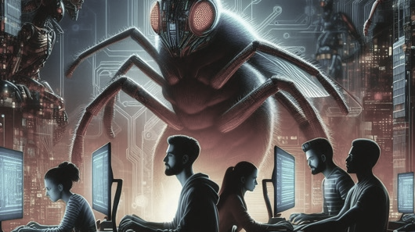
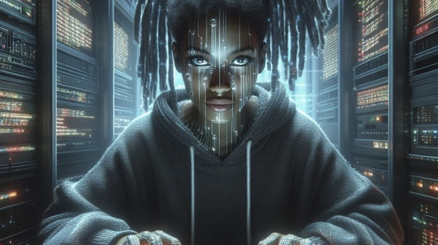
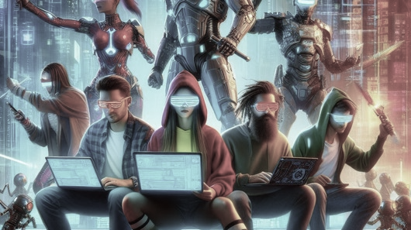
Internal Threats
Broken Access Control
Injections
Security Misconfigurations
Local file include of datasets/unix files
Insecure file transfer protocols (e.g. FTP)
Unauthenticated access
SQL injection in DB2 databases
Job Control Language injections
Rexx scripts injection
Default credentials
Weak password policies
NOT using an external security manager (ESM) like RACF, Top Secret, or ACF2 to control user access

Slide 16
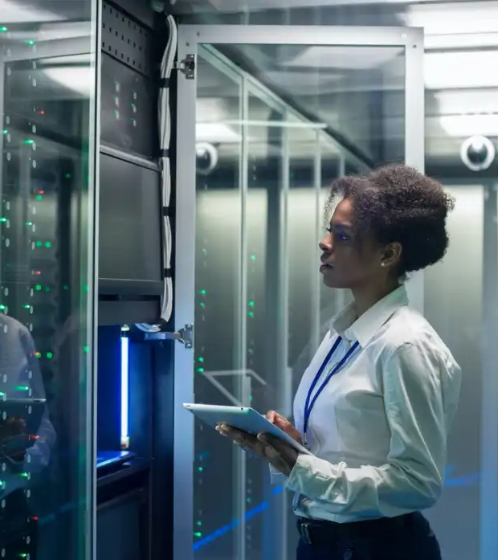
Ways to Secure
Secure with Network Controls
Properly configure your network topology as a whole
Make appropriate use of logical partitions, regions, and ESM tools
Disallow unencrypted protocols and keep up with patches/updates
Secure with Compliance
Implement CIS benchmarking, secure configuration guidelines
Follow DISA STIGS, DoD guides derived from NIST 800-53
Secure with Ongoing Reviews
Monitor traffic with a SOC; logs are robust, take advantage!
Audit identity and access management on a regular basis and implement MFA
Establish recurring audits for all features and conduct frequent penetration testing both internally and through third-parties

Slide 17

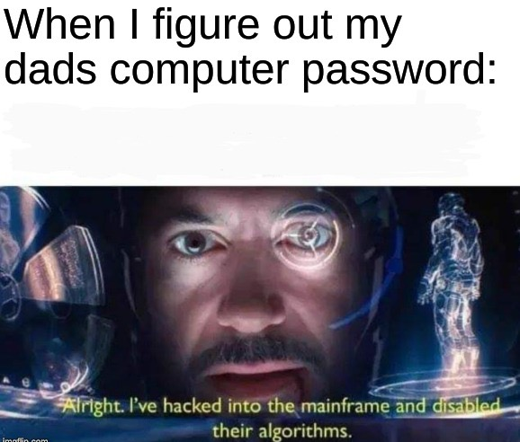
Summary
Mainframe is not going away anytime soon!
We rely on it globally to support finance, healthcare, government, and other critical industries.
There are more possible vulnerabilities now due to increasing integrations.
With diligence, we can combat these threats together.

Slide 18
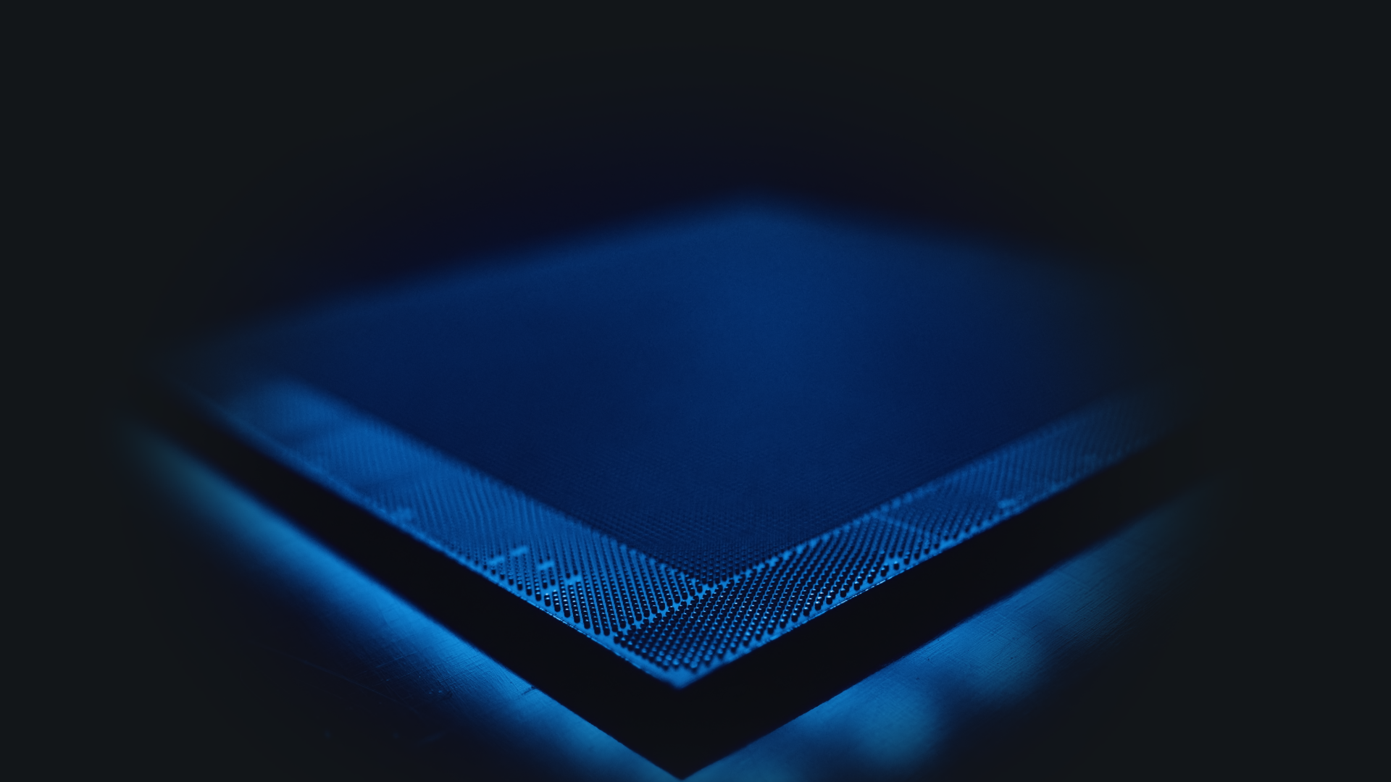



Thank You!
Please stay connected (:
Michelle Eggers
Security Consultant @ NetSPI
Mainframe, Web Application, Network Penetration Testing
michelle.eggers@netspi.com
@saltymiche

